Slide 1
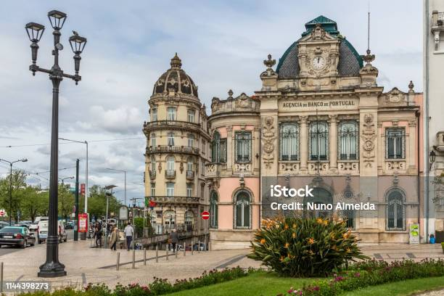
PORTUGESE BANK
PRESENTED BY:
PUJITH KUMAR
ARUN KUMAR
CHANDU
JENISHA
International Conference on Intelligent Computing and Communication (ICICC 24)-AUGUST 21-23, 2024
Notes:
1
jjjj

Slide 2
Abstract
In the modern banking sector, effective marketing strategies are essential to increase customer engagement and product subscriptions. This project focuses on analyzing a Portuguese bank’s direct marketing campaign data to predict whether a customer will subscribe to a term deposit. The dataset consists of customer demographic details, financial background, campaign interaction history, and macro-economic indicators. A complete data analysis is performed to understand customer behavior and identify influential factors. Multiple machine learning models are developed and evaluated to determine the most accurate predictive model. The outcomes of this project help the bank marketing team target potential customers efficiently, reduce operational costs, and improve overall campaign success.
IEEE - International Conference on Vision Towards Emerging Trends in Communication and Networking (ViTECoN’23)
Notes:
2

Slide 3
Introduction
Direct marketing campaigns are widely used by banks to promote financial products such as term deposits. These campaigns often involve contacting customers through phone calls, which can be expensive and time-consuming. Without proper customer targeting, banks may experience low success rates. With the availability of historical marketing data, machine learning provides an effective solution to predict customer responses. This project applies data analytics and machine learning techniques to analyze customer behavior and build a predictive model that assists the bank in identifying customers who are more likely to subscribe to term deposits.
IEEE - International Conference on Vision Towards Emerging Trends in Communication and Networking (ViTECoN’23)
Notes:
3

Slide 4
Problem Identification
Banks face significant challenges in identifying potential customers for term deposit subscriptions. The marketing dataset contains a large number of attributes, including demographic, financial, and economic indicators, which makes manual analysis difficult. Additionally, some features such as call duration can lead to biased predictions if used incorrectly. The absence of accurate prediction systems results in wasted marketing efforts and increased costs. Hence, there is a need for a reliable machine learning model that can accurately predict customer subscription behavior before initiating marketing campaigns.
IEEE - International Conference on Vision Towards Emerging Trends in Communication and Networking (ViTECoN’23)
Notes:
4

Slide 5
Objective
The primary objective of this project is to develop a machine learning model that predicts whether a customer will subscribe to a term deposit. The project also aims to perform in-depth exploratory data analysis to understand customer characteristics and behavior. Other objectives include preprocessing and encoding categorical data, evaluating multiple classification algorithms, selecting the best-performing model, and providing insights and recommendations to improve bank marketing strategies.
IEEE - International Conference on Vision Towards Emerging Trends in Communication and Networking (ViTECoN’23)
Notes:
5

Slide 6
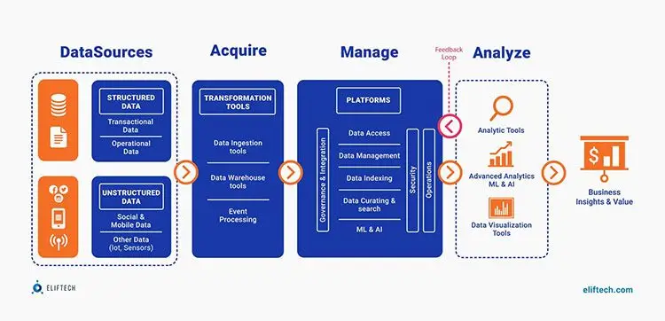
System Architecture
IEEE - International Conference on Vision Towards Emerging Trends in Communication and Networking (ViTECoN’23)
Notes:
6

Slide 7
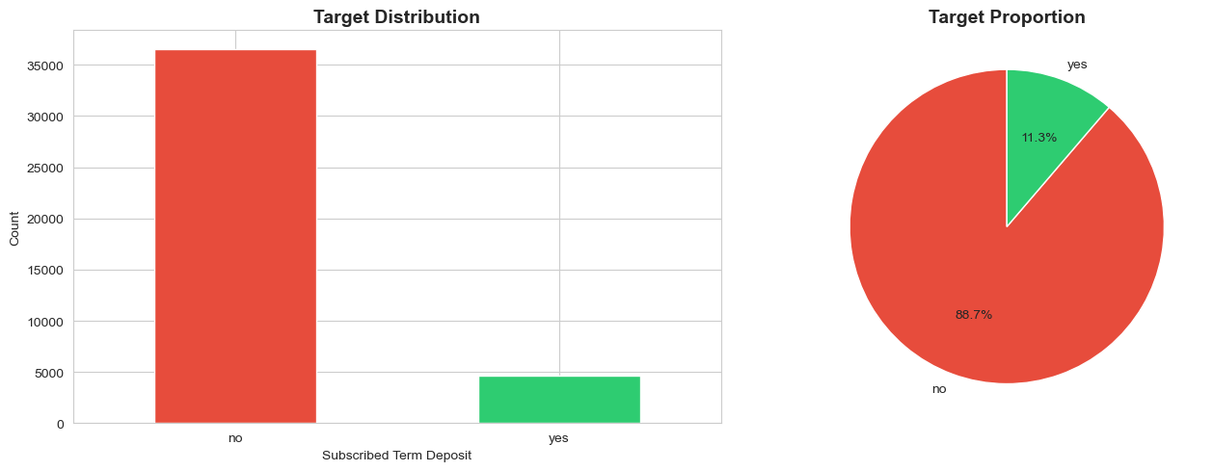
Visualizations
IEEE - International Conference on Vision Towards Emerging Trends in Communication and Networking (ViTECoN’23)
Notes:
7

Slide 8
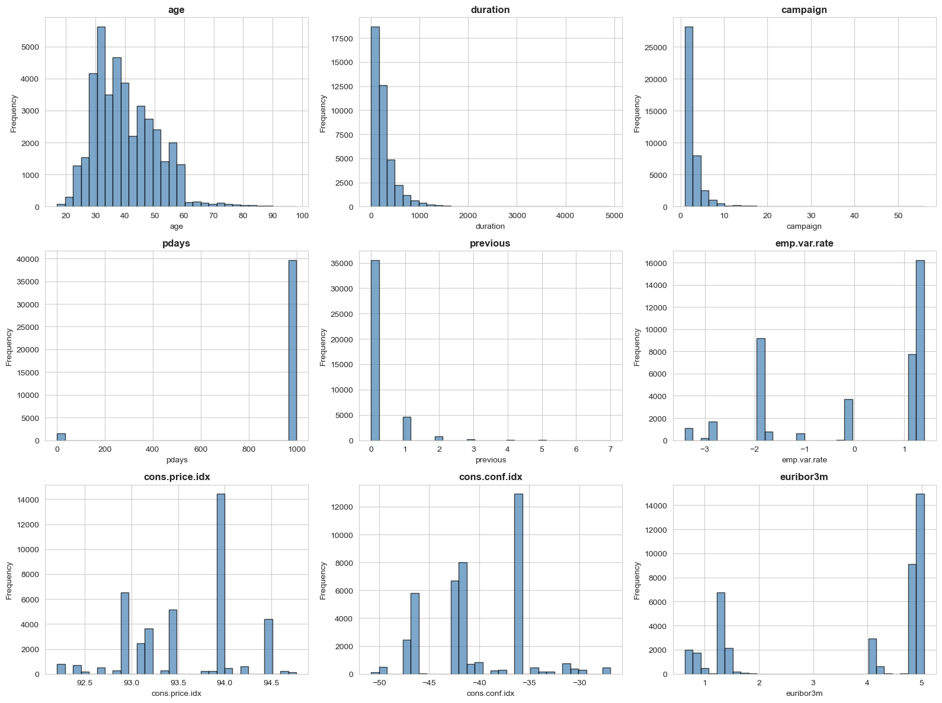
Visualizations
IEEE - International Conference on Vision Towards Emerging Trends in Communication and Networking (ViTECoN’23)
Notes:
8

Slide 9
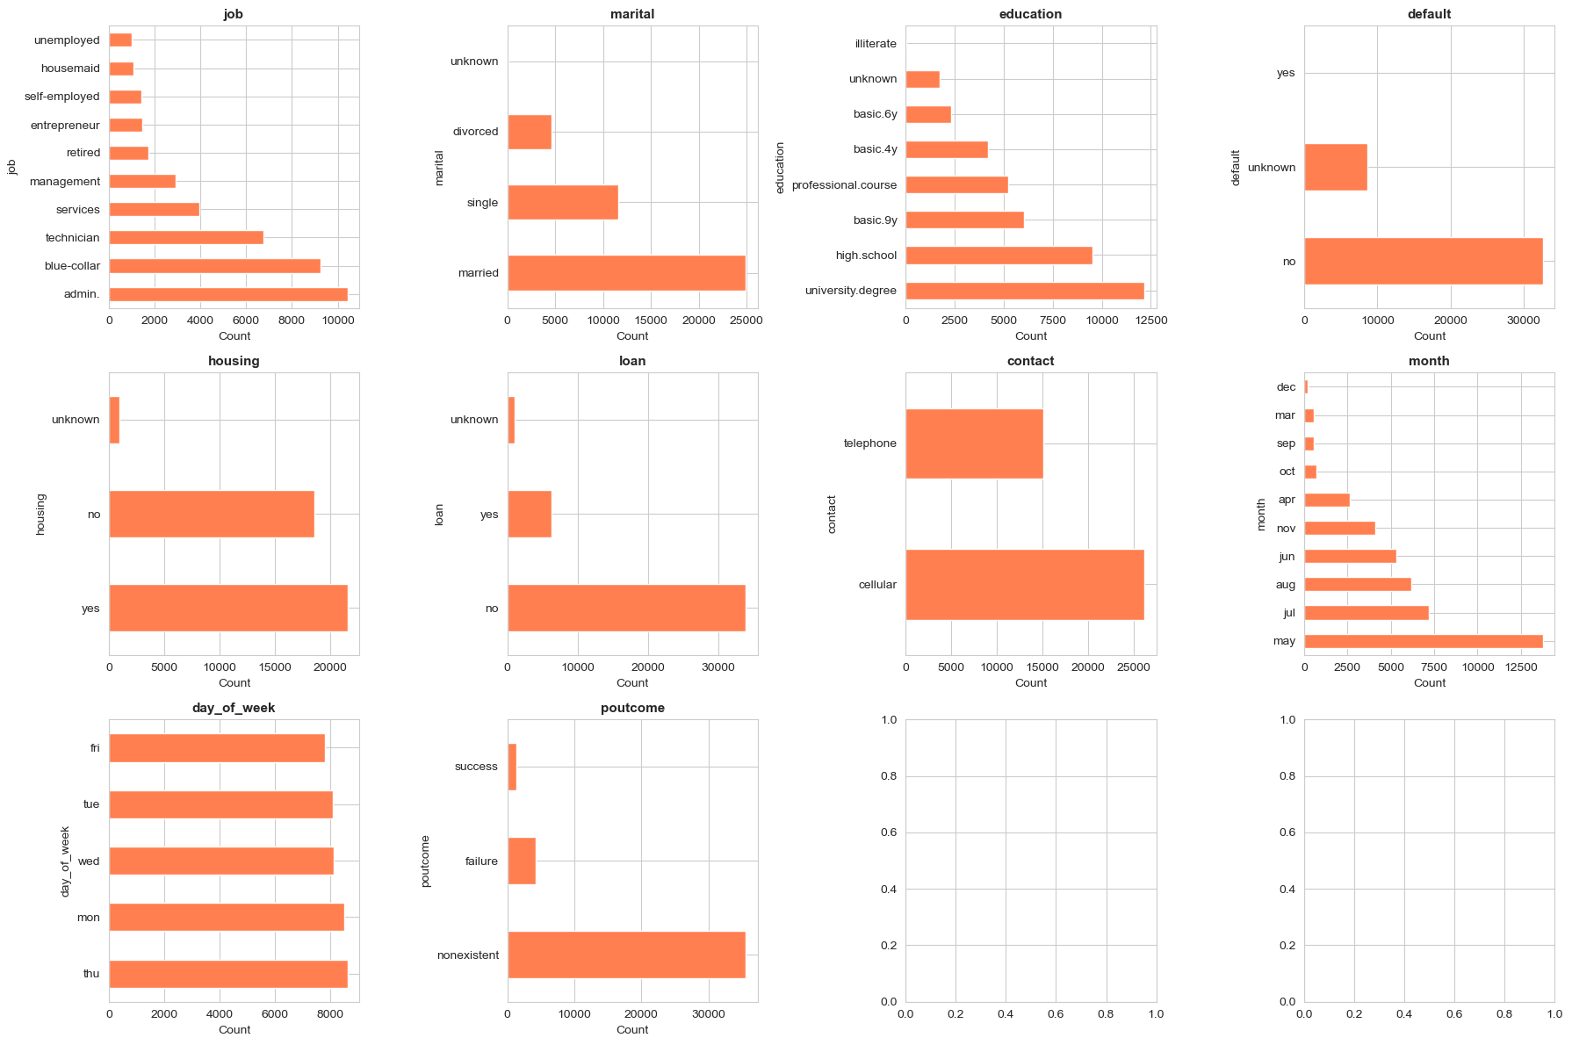
Visualizations
IEEE - International Conference on Vision Towards Emerging Trends in Communication and Networking (ViTECoN’23)
Notes:
9

Slide 10
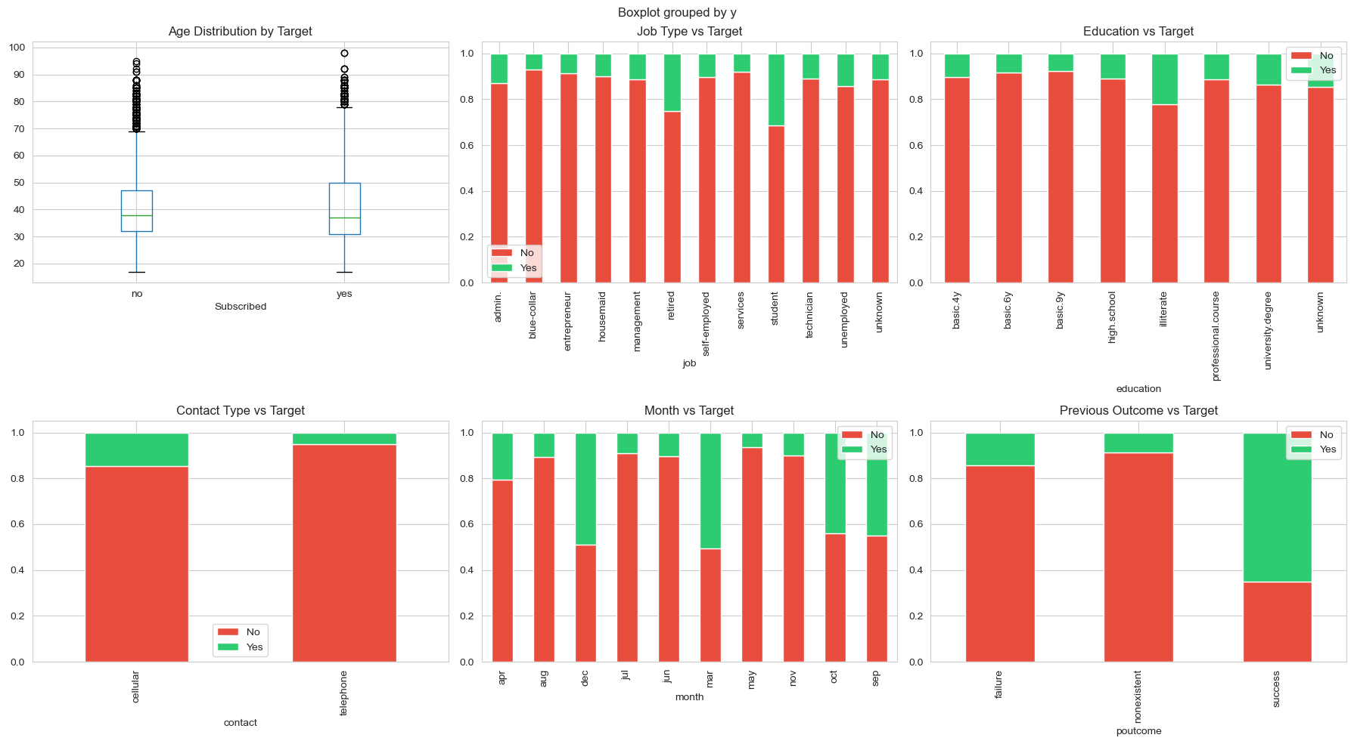
Visualizations
IEEE - International Conference on Vision Towards Emerging Trends in Communication and Networking (ViTECoN’23)
Notes:
10

Slide 11
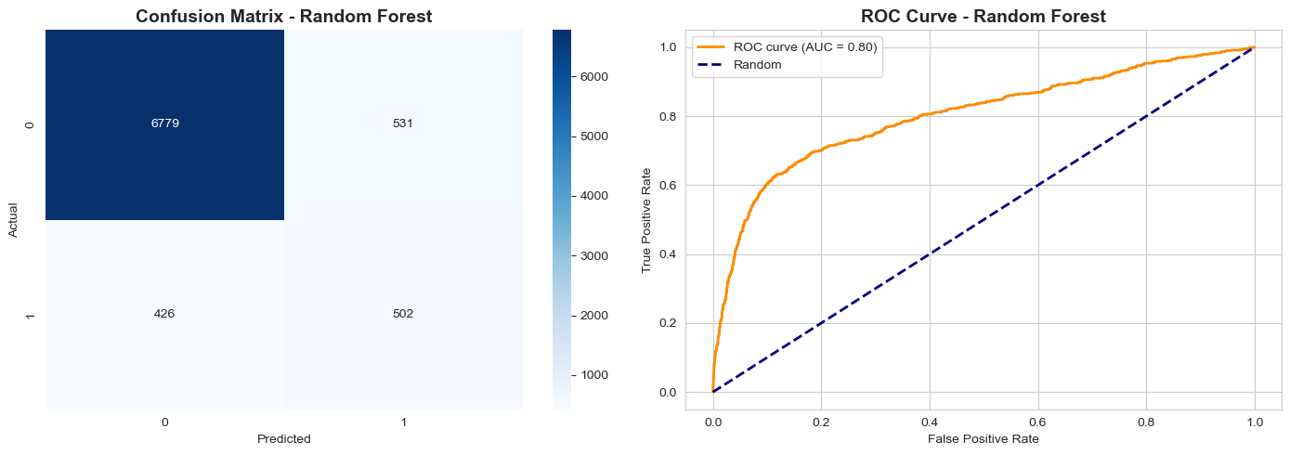
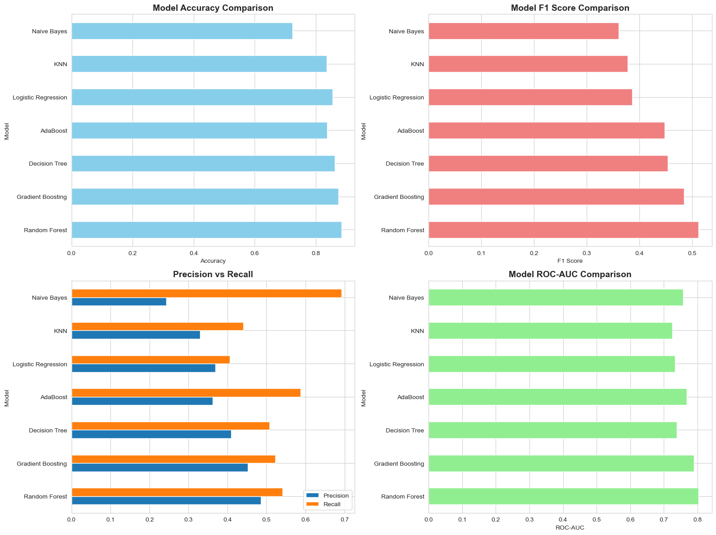
Visualizations
IEEE - International Conference on Vision Towards Emerging Trends in Communication and Networking (ViTECoN’23)
Notes:
11

Slide 12
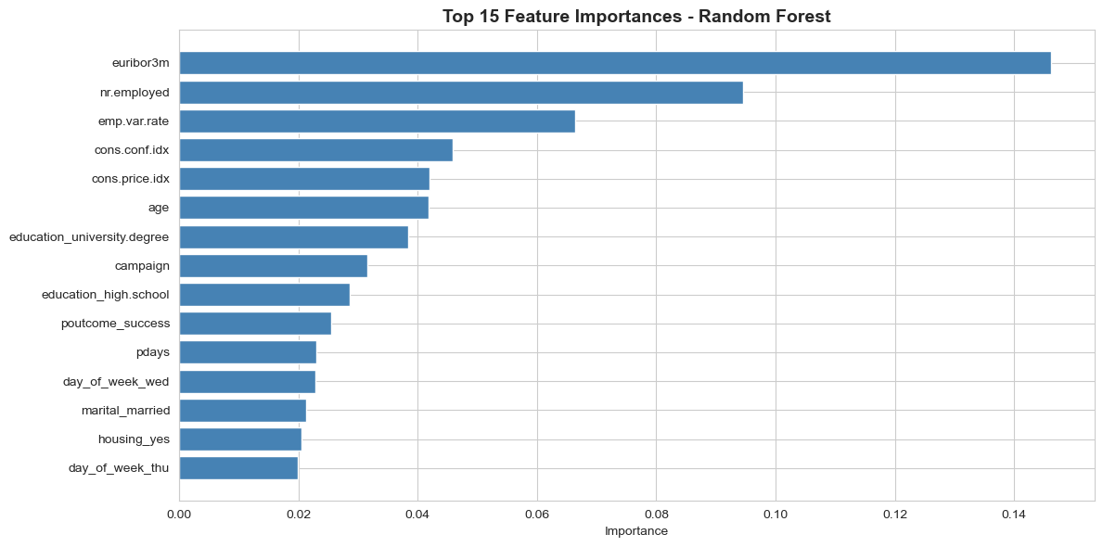
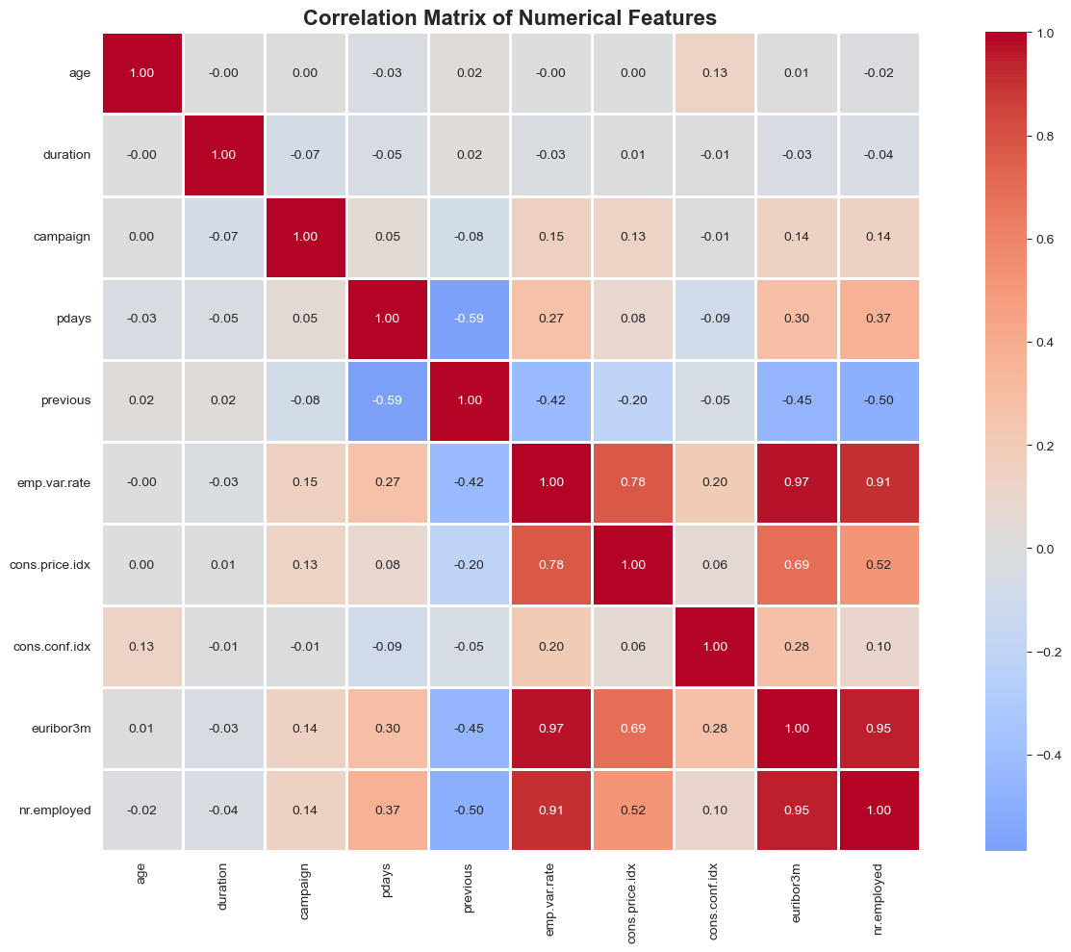
Visualizations
IEEE - International Conference on Vision Towards Emerging Trends in Communication and Networking (ViTECoN’23)
Notes:
12

Slide 13
Related work
Previous research in bank marketing analytics has used statistical techniques and machine learning models such as logistic regression, decision trees, random forests, and boosting algorithms. Studies indicate that customer age, previous campaign outcomes, and economic indicators significantly influence subscription decisions. Many researchers highlight the importance of excluding call-duration features to ensure realistic predictions. This project follows similar methodologies while performing comprehensive model comparison to achieve better predictive performance.
IEEE - International Conference on Vision Towards Emerging Trends in Communication and Networking (ViTECoN’23)
Notes:
13

Slide 14
Key Insights
Customer subscription to term deposits is strongly influenced by previous campaign outcomes, indicating the importance of customer history.
Age and occupation play a significant role, with middle-aged and employed customers showing higher subscription rates.
Contact type and timing affect campaign success, highlighting the need for optimized communication strategies.
Economic indicators such as interest rates and employment variation impact customer decision-making.
Removing biased features like call duration ensures realistic and reliable model predictions.
IEEE - International Conference on Vision Towards Emerging Trends in Communication and Networking (ViTECoN’23)
Notes:
14

Slide 15
Proposed Methodology
The proposed methodology starts with importing the bank marketing dataset and performing initial data inspection. Data preprocessing involves handling categorical variables using encoding techniques and scaling numerical attributes if required. Exploratory data analysis is conducted to visualize feature distributions and relationships with the target variable. Irrelevant or biased features are removed. The dataset is split into training and testing sets. Multiple machine learning classification models are trained and evaluated using metrics such as accuracy, precision, recall, and F1-score. The best-performing model is selected for final deployment.
IEEE - International Conference on Vision Towards Emerging Trends in Communication and Networking (ViTECoN’23)
Notes:
15

Slide 16
Results and Discussion
The results of the project indicate that machine learning models can effectively predict customer subscription behavior. Exploratory analysis shows that factors such as previous campaign success, contact type, and economic indicators have a strong impact on customer decisions. Model comparison reveals that advanced classification models outperform basic algorithms. The selected model demonstrates improved prediction accuracy and consistency, making it suitable for real-world marketing applications. These results enable the bank to optimize marketing resources and focus on high-potential customers.
International Conference on Intelligent Computing and Communication (ICICC 24)-AUGUST 21-23, 2024
Notes:
16

Slide 17
Conclusion
This project demonstrates the effective application of machine learning techniques to predict customer subscription behavior in bank marketing campaigns. Exploratory data analysis reveals that customer demographics, previous campaign outcomes, contact strategies, and economic indicators significantly influence term deposit subscriptions. Advanced classification models outperform traditional approaches by capturing complex patterns in customer behavior. The proposed predictive system enables banks to target high-potential customers more efficiently, reduce unnecessary marketing costs, and improve overall campaign success. This study highlights the value of data-driven decision-making in modern banking, with future scope for real-time deployment and CRM integration.
International Conference on Intelligent Computing and Communication (ICICC 24)-AUGUST 21-23, 2024
Notes:
17

